Slide 1
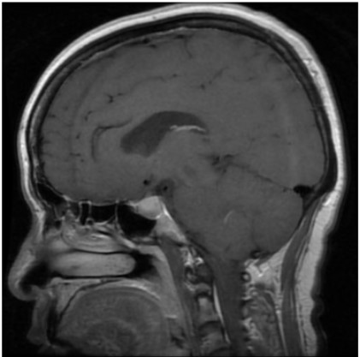
Brain Tumor Detection
This project uses deep learning to detect brain tumors from MRI images. A Convolutional Neural Network (CNN) is trained to classify different types of brain tumors. The model is then deployed with Streamlit, allowing users to upload MRI scans and get instant predictions.This tool aims to help doctors by providing a quick and automated diagnosis support system.It is a simple, easy-to-use application that demonstrates the power of AI in healthcare.

Slide 2
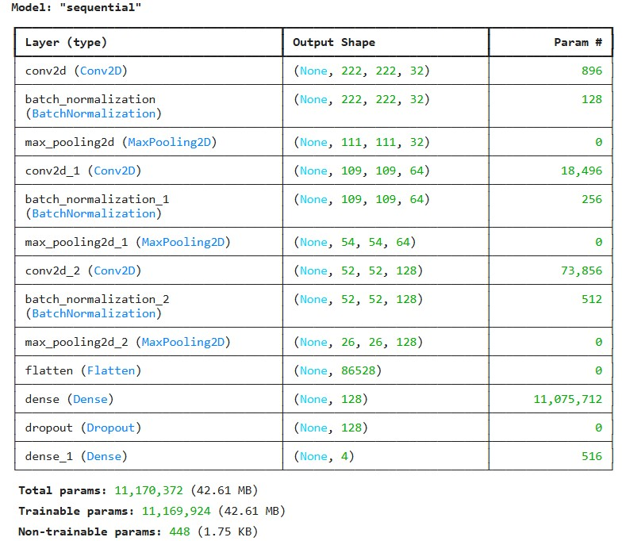
System Architecture

Slide 3
Technologies Used
Programming Language: Python
Deep Learning Framework: TensorFlow, Keras
Image Processing & Augmentation: PIL, NumPy, ImageDataGenerator
Data Analysis & Visualization: Pandas, Matplotlib, Seaborn
Model Evaluation: Scikit-learn
Deployment: Streamlit
Model Type: Convolutional Neural Network (CNN)
Optimization & Metrics: Adam, Adamax, Precision, Recall
Dataset: Link

Slide 4
Scope
Detect brain tumors from MRI images using deep learning (CNN).
Classify tumors into four categories: Glioma, Meningioma, Pituitary, and No Tumor.
Provide a simple and accessible web interface using Streamlit.
Assist doctors and medical staff with quick, automated predictions.
Lay the foundation for more advanced AI-assisted medical diagnosis tools.
Potential to extend the model for DICOM images and real-time hospital usage.

Slide 5
Thank You

